Slide 1
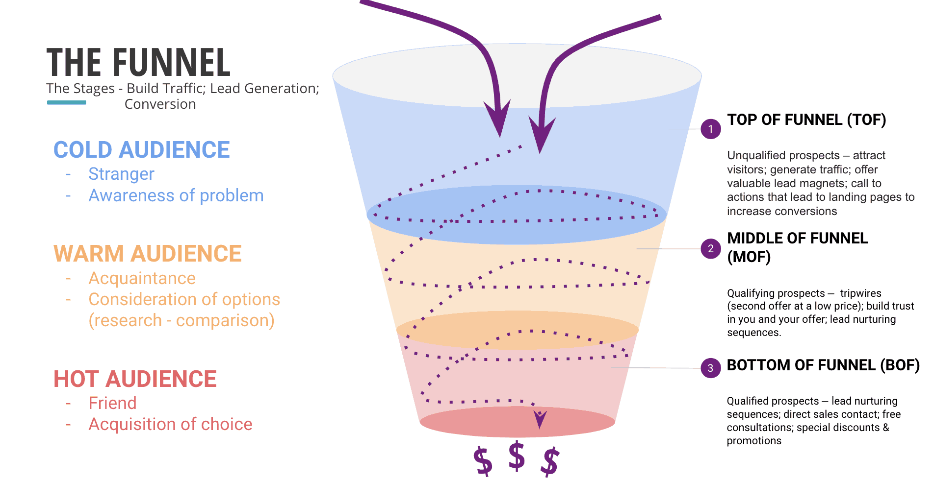
Sales Funnel
TOP OF FUNNEL (TOF)
Unqualified prospects – attract visitors, Generate traffic, offer valuable lead magnets, call to actions that lead to landing pages to increase conversations.
COLD AUDIENCE
Stranger, Awareness of Problem
MIDDLE OF FUNNEL (MOF)
Qualifying prospects – tripwires (second offer at a low price), build trust in you & your offer, lead nurturing sequences.
WARM AUDIENCE
Acquaintance, Consideration of options (research - comparison)
BOTTOM OF FUNNEL (BOF)
Qualifying prospects – lead nurturing sequence, direct sales contact, free consultations, discounts & promotions
HOT AUDIENCE
Friend, Acquisition of choice

Slide 2
Traditional
Marketing Revolution
Television, broadcast, 1-way
AWARENESS
PR, event, experiential, media
Radio/ Print, promotional
CONSIDERATION
Radio/ Print, QR code, augmented reality
Sales person, POS, upsell
INTENT
WOM, Social referral
Cash register: cashier, POS
Transaction
Transaction
Geolocation, shared experience
Consumer only experience
CONSUMPTION
Social experience, photo sharing, value add
Consumer & offline community
OPTIMIZATION
WOM, shared experience, social recommendations
Offline
ADVOCACY
Blog, Social profiles

Slide 3
Sales Funnel
Marketing
Reaction/ Response
Lead Management Process
MARKETING
LEAD
First Contacts
Following Contacts
Offers
Negotiations
Opportunity Management Process
SALES
OPPORTUNITY
Close

Slide 4
Sales Funnel
Programs & Campaigns
Engage Prospects & Partners
Orchestrate Opportunities
Close Sales
Deliver/Expand
TAM
100%
Demand Funnel
Sales Funnel Funnel
ACTIVE TAM
20%
AWARE
75%
ENGAGED
35%
QUALIFIED LEAK
5%
WORKING LEAD
10%
QUALIFIED PROSPECT
40%
LIKELY
75%
HIGHLY LIKELY
95%
CLOSED
100%
CLTV
Buyer Intent
Touch
Response
Score
Sales Ready
Sales Qualified
Verbal
T&Cs
Contract
Customer
AWARE
CONSIDER
DECIDE
IMPLEMENT

Slide 5

Sales Funnel Dashboard
Overall Revenue
Sales Funnel
Revenue Comparison
Product Positioning 44.80%
Negotiation 22.48%
Documentation 12.25%
Approval 3.60%
Disbursement 0.36%
Overall Revenue
Lead Conversion
Regionwide Revenue
82
Bad
Good

